Slide 1

7023T
Advanced Database Systems
Session 03
Introduction to Kimball’s Lifecycle
This presentation is based on Michael A. Fudge, Jr.

Slide 2
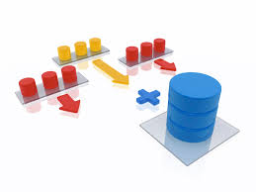
Two Main Data Warehouse Development Methodologies
Top-down Approach
The Inmon’s approach
DW is developed based on the Enterprise wide data model
DW as a single repository feeds data into data marts
Longer to implement
May fail due to the lack of patience and commitment
Bottom-up Approach
The Kimball’s approach
Starts with one data mart (ex. sales); later on additional data marts are added (ex. collection, marketing, etc.)
Data flows from source into data marts, then into the data warehouse
Faster to implement
Implementation in stages
Need to ensure consistency of metadata

Slide 3
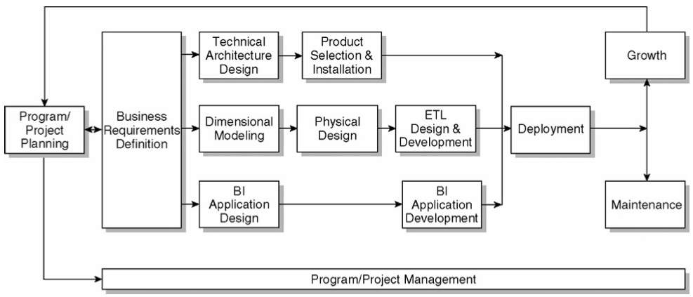
The Kimball Lifecycle Diagram

Slide 4

The Kimball Lifecycle
Illustrates the general flow of a DW implementation
Identifies task sequencing and highlights activities that should happen concurrently
May need to be customized to address the unique needs of your organization
Not every detail of every Lifecycle task will be performed on every project

Slide 5
The Kimball Lifecycle Diagram

Slide 6

Program/Project Planning
Project planning
Scope definition understanding business requirements
Tasks’ identification
Scheduling
Resource planning
Workload assignment
The end document represents a blueprint of the project

Slide 7

Program/Project Management
Enforces the project plan
Activities:
Status monitoring
Issue tracking
Development of a comprehensive communication plan that addresses both the business and IT units

Slide 8
The Kimball Lifecycle Diagram

Slide 9

Business Requirements Definition
Success of the project depends on a solid understanding of the business requirements!!!
Understanding the key factors driving the business is crucial for successful translation of the business requirements into design considerations
Three tracks following tracks follows this step:
Technology
Data
Bussiness intelligence Applications

Slide 10
The Kimball Lifecycle Diagram Technology Track

Slide 11

Technology Track
Technical Architecture Design
Overall architectural framework and vision
Considerations:
The business requirements
Current technical environment
Planned strategic technical directions

Slide 12

Product Selection and Installation
Evaluation and selection of
Products that will deliver needed capabilities
Hardware platform
Database management system
Extract-transformation-load (ETL) tools
Data access query tools
Reporting tools must be evaluated
Installation of selected products/components/tools
Testing of installed products to ensure appropriate end-to-end integration within the data warehouse environment.

Slide 13
The Kimball Lifecycle Diagram Data Track

Slide 14

Dimensional Modeling
Detailed data analysis of a single business process is performed to identify the fact table granularity, associated dimensions and attributes, and numeric facts.
Dimensional models contain the same data content and relationships as models normalized into third normal form, but structured differently.
Improve understandability and query performance required by DW/BI
Primary constructs of a dimensional model
Fact tables
Dimension tables

Slide 15
Dimensional Modeling
Fact table
Contain the metrics resulting from a business process or measurement event, such as the sales ordering process or service call event
Fact table’s granularity should be set at the lowest, most atomic level captured by the business process, this allows for maximum flexibility and extensibility.
Business users will be able to ask constantly changing, free-ranging, and very precise questions.

Slide 16
Dimensional Modeling
Dimensional table
Contain the descriptive attributes and characteristics associated with specific, tangible measurement events, such as the customer, product, or sales representative associated with an order being placed.
Dimension attributes are used for constraining, grouping, or labeling in a query.
Hierarchical many-to-one relationships are denormalized into single dimension tables.

Slide 17
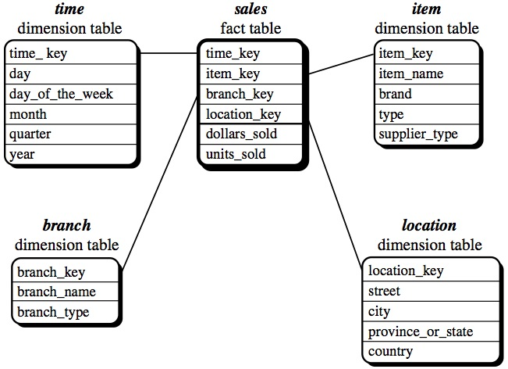
Example of Star Schema

Slide 18
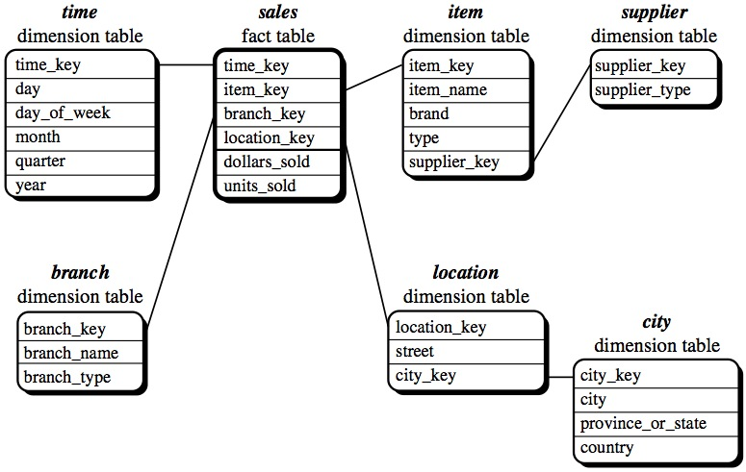
Example of Snowflake Schema

Slide 19
Snowflake Schema
Disadvantages:
Fact tables are typically responsible for 90% or more of the storage requirements, so the benefit is normally insignificant.
Normalization of the dimension tables ("snowflaking") can impair the performance of a data warehouse.
Advantages:
If a dimension is very sparse the dimension table may occupy a significant proportion of the database and snowflaking may be appropriate.
In practice, many data warehouses will normalize some dimensions and not others, and hence use a combination of snowflake and classic star schema.

Slide 20
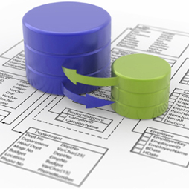
Physical Design
Defining the physical structures
Setting up the database environment
Setting up appropriate security
Preliminary performance tuning strategies, from indexing to partitioning and aggregations.
If appropriate, OLAP databases are also designed during this process.

Slide 21

ETL Design and Development
The MOST important stage
70% of the risk and effort in the DW project is attributed to this stage
ETL system capabilities:
Extraction
Cleansing and conforming
Delivery and management

Slide 22
ETL
Raw data is extracted from the operational source systems and is being transformed into meaningful information for the business
ETL processes must be architected long before any data is extracted from the source
ETL system strives to deliver high throughput, as well as high quality output
Incoming data is checked for reasonable quality
Data quality conditions are continuously monitored
Kimball calls ETL a “data warehouse back room”

Slide 23
The Kimball Lifecycle Diagram Bussiness Intelligence Application Track

Slide 24

Business Intelligence Application Track
Applications that query, analyze, and present information from the dimensional model.
BI applications deliver business value from the DW/BI solution, rather than just delivering the data
The goal is to deliver capabilities that are accepted by the business to support and enhance their decision making.

Slide 25
BI Application Design & Development
BI Application Design
Identify the candidate BI applications and appropriate navigation interfaces to address the users’ needs and needed capabilities.
Produce BI application specification
BI Application Development
Configuration of the business metadata and tool infrastructure
Construction and validation of the specified analytic and operational BI applications and the navigational portal

Slide 26
The Kimball Lifecycle Diagram Bussiness Intelligence Application Track

Slide 27

Deployment
It is crucial that adequate planning was performed to make sure that:
The results of technology, data, and BI application tracks are tested and fit together properly
Appropriate education and support infrastructure is in place.
It is critical that deployment be well orchestrated
Deployment should be deferred if all the pieces, such as training, documentation, and validated data, are not ready for production release.

Slide 28
The Kimball Lifecycle Diagram Maintenance

Slide 29

Maintenance
Occurs when the system is in production
Includes:
Technical operational tasks that are necessary to keep the system performing optimally
Usage monitoring
Performance tuning
Index maintenance
System backup
Ongoing support, education, and communication with business users

Slide 30
The Kimball Lifecycle Diagram Growth

Slide 31

Growth
DW systems tend to expand (if they were successful)
Is considered as a sign of success
New requests need to be prioritized
Starting the cycle again
Building upon the foundation that has already been established
Focusing on the new requirements

